Slide 1
Transmission Line
Introduction

Slide 2
INTRODUCTION
The electrical lines which are used to transmit the electrical waves along them are called transmission line.
The transmission line theory
is the theory of propagation of the electric waves which are transmitted along the transmission line .
e.g.:- telephone message and electrical power signals.

Slide 3
INTRODUCTION
In an electronic system, the delivery of power requires the connection of two wires between the source and the load.
At low frequencies,
power is considered to be delivered to the load through the wire.
In the microwave frequency region,
power is considered to be in electric and magnetic fields that are guided from place to place by some physical structure.
Any physical structure that will guide an electromagnetic wave place to place is called a Transmission Line.

Slide 4
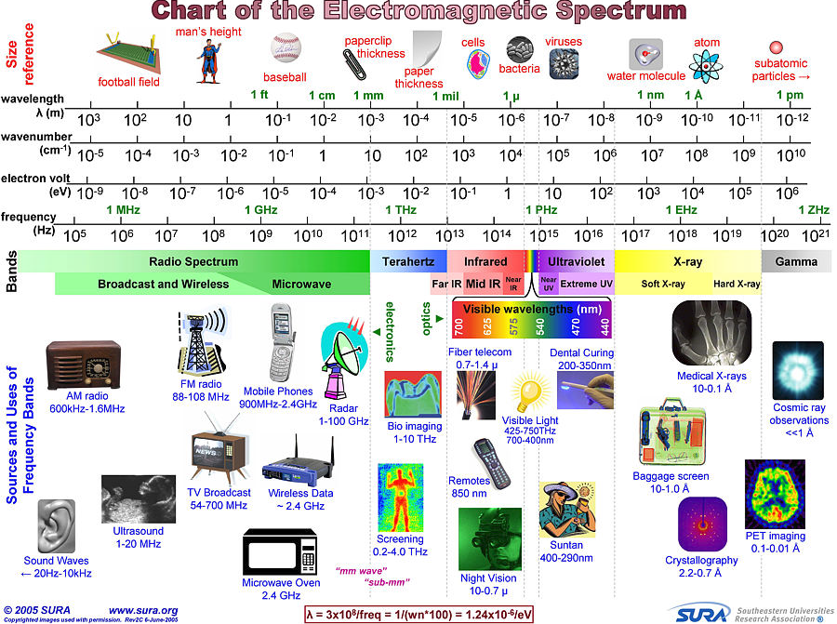

Slide 5
Analysis of differences between Low and High Frequency
At low frequencies,
The circuit elements are lumped since voltage and current waves affect the entire circuit at the same time.
At microwave frequencies,
such treatment of circuit elements is not possible since voltage and current waves do not affect the entire circuit at the same time.
The circuit must be broken down into unit sections within which the circuit elements are considered to be lumped.
This is because the dimensions of the circuit are comparable to the wavelength of the waves according to the formula:
l = c/f
where,
c = velocity of light
f = frequency of voltage/current

Slide 6
The transmission line are assumed to consist of a pair of wires
which are uniform throughout the whole length.
The transmission line parameters like resistance, inductance and capacitance are not physically separable unlike circuit elements of a lamped circuit.
In the analysis of transmission lines ,only steady state currents and voltage are considered.
The analysis includes the finding of current and voltage at any point along the length of the line ,when a known voltage is continuously applied at one end.
The end to which the voltage is applied is called sending end while the end at which the signal are received is called receiving end.

Slide 7
Types of Transmission Lines
Two wire line
Coaxial cable
Waveguide
Rectangular
Circular
Planar Transmission Lines
Strip line
Microstrip line
Slot line
Fin line
Coplanar Waveguide
Coplanar slot line

Slide 8
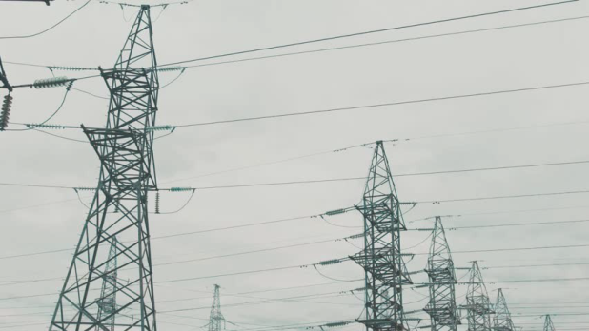
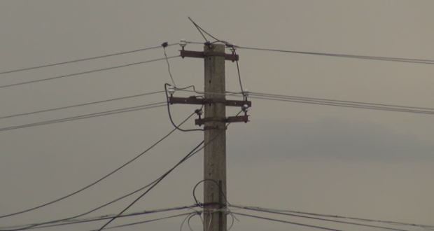
OPEN-WIRE LINE
These lines are the parallel conductors open to air hence called open wire lines.
The conductors separated by air as the dielectric and mountain on the towers.
Example:
Telephone lines
Electrical power lines

Slide 9
OPEN-WIRE LINE
Advantages:
Less capacitance compare to underground cable
Disadvantages:
Requirement of towers/poles
High initial cost
Affected by atmospheric condition. (like wind, air, ice)
Shorting by flying objects

Slide 10
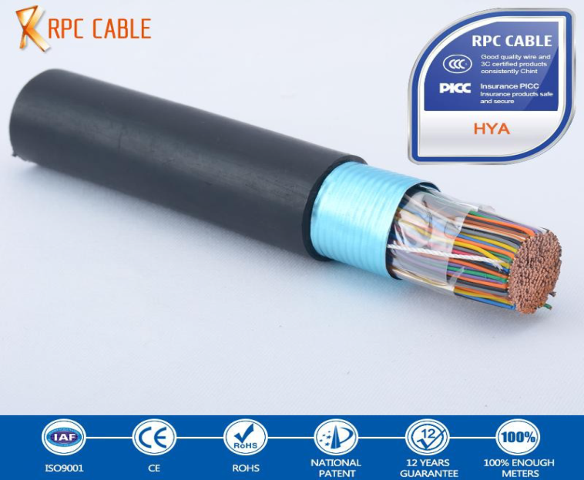
CABELS
These are underground lines.
Telephone cables consist hundred of conductors which are individually insulated with paper.

Slide 11

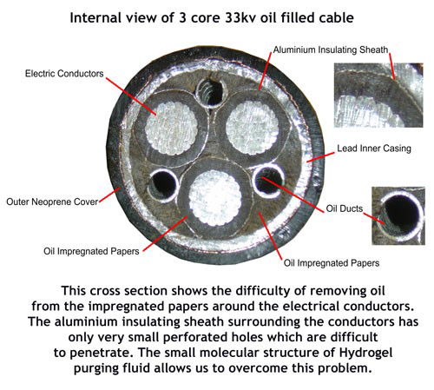
Electrical transmission cables consists two or three large conductor which insulated with oil impregnated paper or other solid dielectric materials.

Slide 12
CABELS
Advantages:
Reduced range of electromagnetic filed (EMF) emission, into the surrounding area.
Underground cables pose no hazard to low flying aircraft or to wildlife.
Much less subject to conductor theft, illegal connections.
Disadvantages:
Undergrounding is more expensive.
Whereas finding and repairing overhead wire breaks can be accomplished in hours, underground repairs can take days or weeks.

Slide 13
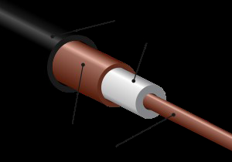
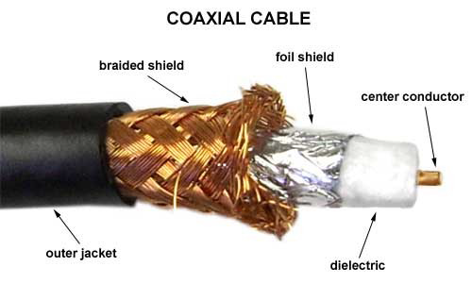
CO-AXIAL LINES
As the name suggests, there are two conductors which are co-axially placed.
One conductor is hollow and other placed co-axially inside the first conductor.

Slide 14
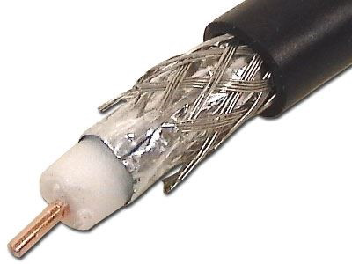
The dielectric may be solid or gaseous.
These lines use for high voltage levels.
Advantages:
Lower error rates.
Coaxial cable shielding reduces noise .
Disadvantages:
More expensive
to install compare to
twisted pair cable.

Slide 15
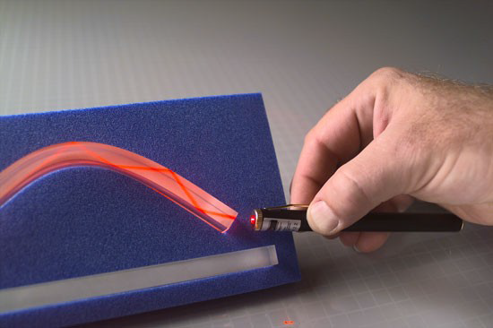
WAVE GUIDES
These type of transmission lines are used to transmit the electrical waves at micro frequencies.
Constructionally these are the hollow conducting tubes having uniform cross section.

Slide 16
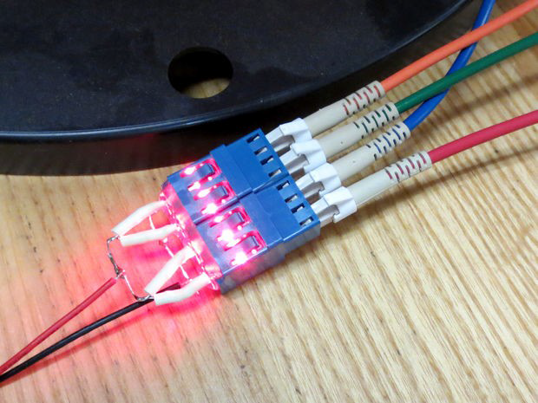
The energy is transmitted from inner walls of the tube by the phenomenon of total internal reflection.

Slide 17
WAVE GUIDES
Advantages:
Fiber optic cables have a much greater bandwidth than metal cables.
Low Power Loss.
Since the fiber is a dielectric, it does not present a spark hazard.
Optical fibers are difficult to tap.
Disadvantages:
Cables are expensive to install but last longer than copper cables.
Transmission on optical fiber requires repeating at distance intervals.
Optical fibers require more protection around the cable compared to copper.

